Slide 1

Introduction to R
Shyh-Weir Tzang
Asia University
2018/08/10

Slide 2
Example: read .csv file
file = “https://raw.githubusercontent.com/swtzang/Intro-to-R/master/AAPL.csv”
aapl<-read.csv(file)
str(aapl)
dat1<- as.Date(aapl[,1], "%Y-%m-%d")
aapl.xts<- as.xts(aapl[,-1], order.by=dat1)
plot(aapl.xts)
aapl.1<-as.numeric(aapl.xts$Close[1])
aapl.cum<-aapl.xts$Close/aapl.1
plot(aapl.cum)
#
plot(x=aapl.cum, xlab = "time", ylim=c(0.5, 1.5), ylab= "Cumulative Returns",
main = "Cumulative Returns",major.ticks="months")
http://blog.revolutionanalytics.com/2014/01/quantitative-finance-applications-in-r-plotting-xts-time-series.html

Slide 3
Example: read .csv file
Download “3firmExample_data3.csv” from github
file1= https://raw.githubusercontent.com/swtzang/Intro-to-R/master/3firmExample_data3.csv
firm_data1 = read.csv(file1, header=T, sep=", stringsAsFactors = F)
#convert firm_data1 into time series data
date1 = as.Date(firm_data1[,1], "%Y/%m/%d")
firm_data1.xts = as.xts(firm_data1[,-1], order.by = date1)

Slide 4
Date format in excel
install.packages(pkgs=“readxl")
library(readxl)
firm_data2 = read_excel(’3firmExample_data1.xlsx')
# Change system time to English so that we can change date format smoothly
Sys.getlocale(category = "LC_TIME")
Sys.setlocale("LC_TIME", "English")
date2 = firm_data2[,1]
date22<- paste(substr(date2,1,3),"-01-",substr(date2,5,6),sep="")
datetoformat <- as.Date(date11,"%b-%d-%y")
#convert firm_data2 into time series data
firm_data2.xts = as.xts(firm_data2[,-1], order.by = datetoformat)
http://www.statmethods.net/input/dates.html
http://www.sthda.com/english/wiki/reading-data-from-excel-files-xls-xlsx-into-r

Slide 5
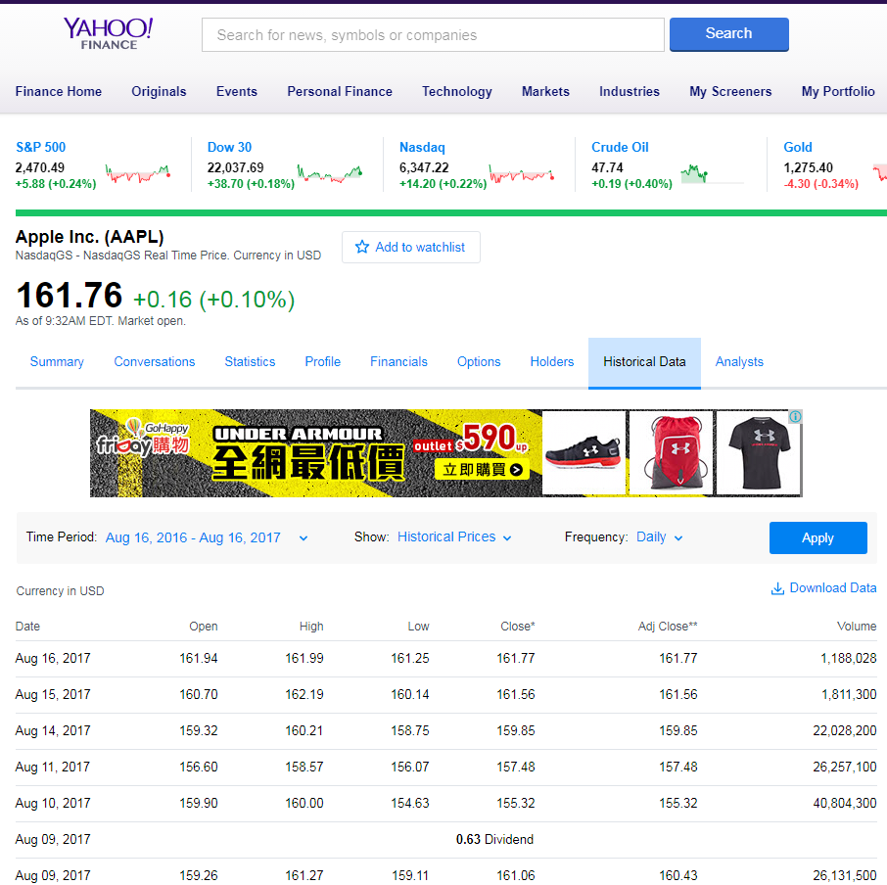

Slide 6
Example
Go to yahoo finance to download the stock price of apple computer (ticker: AAPL) for the past 2 years.
Hint: use package quantmod()

Slide 7
Using library quantmod
library(quantmod)
setwd()
from.dat <- as.Date("2018/01/01", format="%Y/%m/%d")
aapl <-getSymbols("AAPL", auto.assign = F, from = from.dat)
saveRDS(aapl, ’aapl_2018.rds’)
aapl01<-readRDS(’aapl_2018.rds’)
head(aapl)
aapl.close<-aapl[,6]
aapl.ret<-dailyReturn(aapl.close)
plot(aapl.ret)
hist(aapl.ret)
chartSeries(aapl)
addMACD()
addRSI()
symbols <- stockSymbols()

